Slide 1
Hotel Reservation Analysis
Using SQL
Name : Kanak Chokhani
Batch: MIP-DA-08

Slide 2
OVERVIEW
In the hotel industry, information helps make guest stays more enjoyable. I analyzed hotel booking data to understand guest preferences, booking behaviors, and factors impacting the hotel's success. Using SQL,
I shifted through the data to find precise answers to key questions.

Slide 3
Dataset Details:
Booking_ID: A unique identifier for each hotel reservation.
no_of_adults: The number of adults in the reservation.
no_of_children: The number of children in the reservation.
no_of_weekend_nights: The number of nights in the reservation that fall on
weekends.
no_of_week_nights: The number of nights in the reservation that fall on weekdays.
type_of_meal_plan: The meal plan chosen by the guests.
room_type_reserved: The type of room reserved by the guests.
lead_time: The number of days between booking and arrival.
arrival_date: The date of arrival.
market_segment_type: The market segment to which the reservation belongs.
avg_price_per_room: The average price per room in the reservation.
booking_status: The status of the booking.

Slide 4
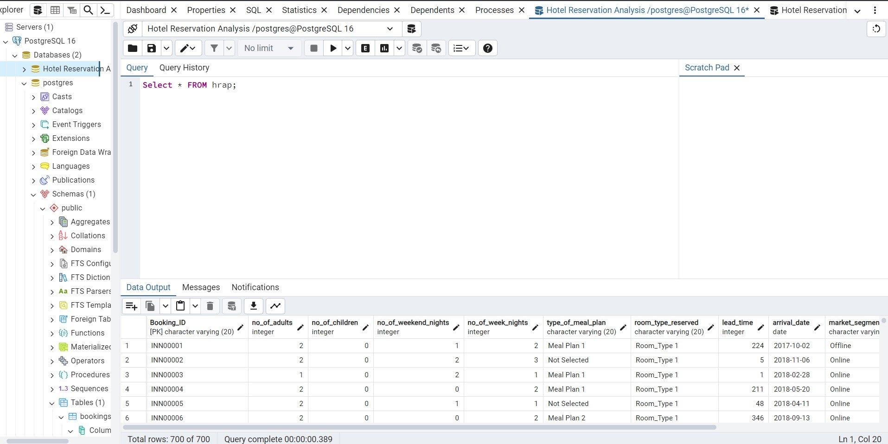
Import Data From CSV File by SQL Server
Product A
Feature 1
Feature 2
Feature 3
Product B
Feature 1
Feature 2
Feature 3

Slide 5
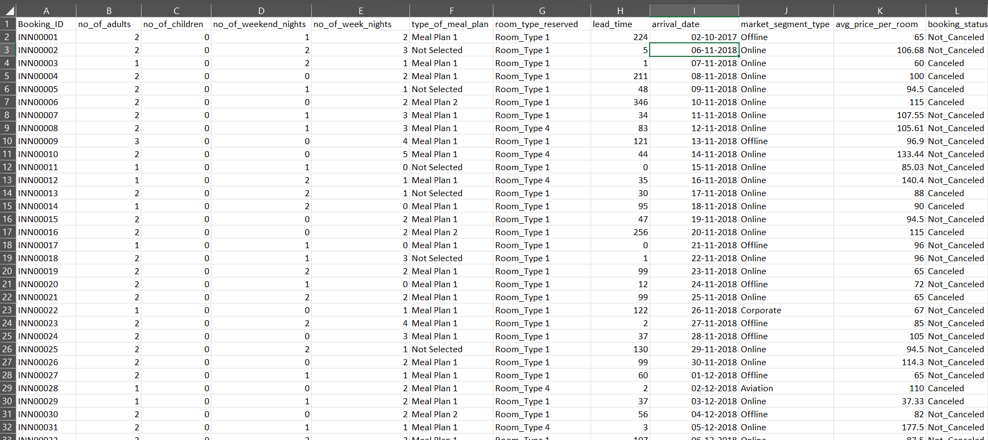
Excel

Slide 6
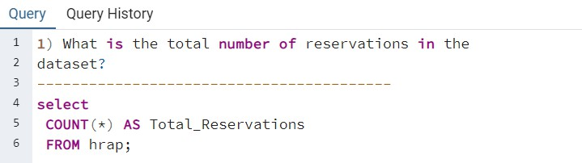
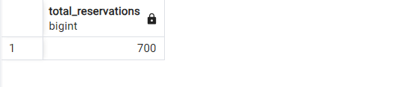
SQL QUERY

Slide 7
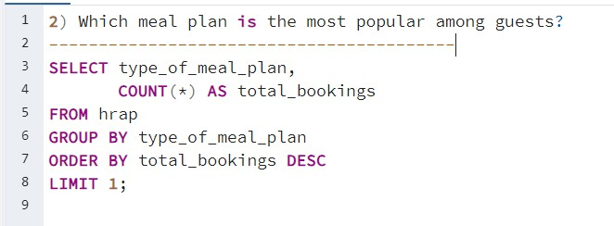
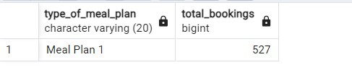

Slide 8
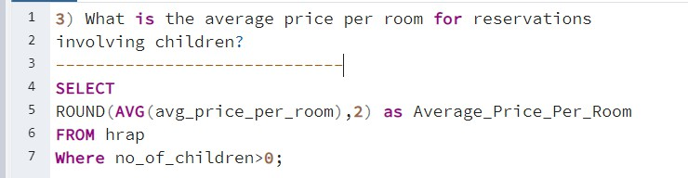
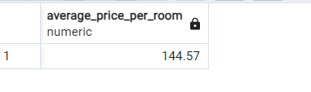

Slide 9
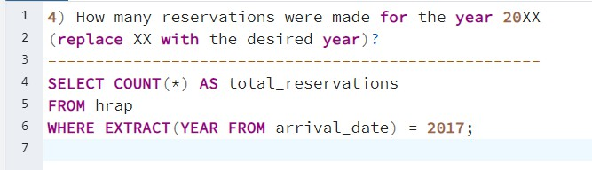
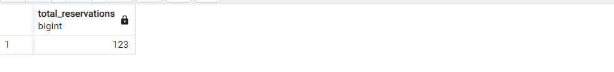

Slide 10
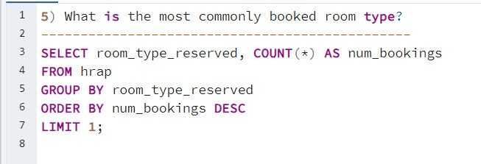
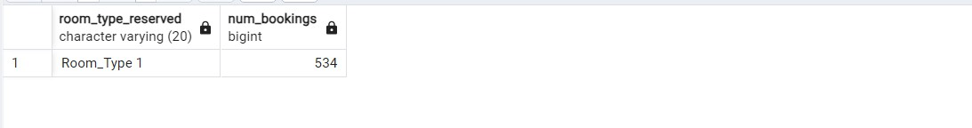

Slide 11
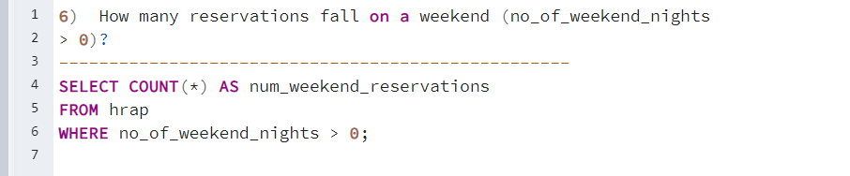
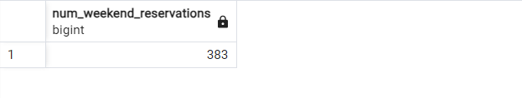

Slide 12
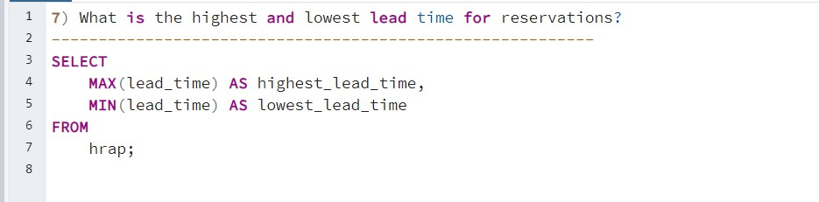
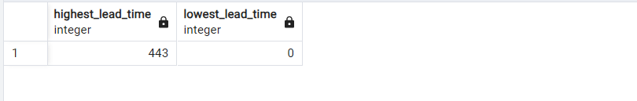

Slide 13
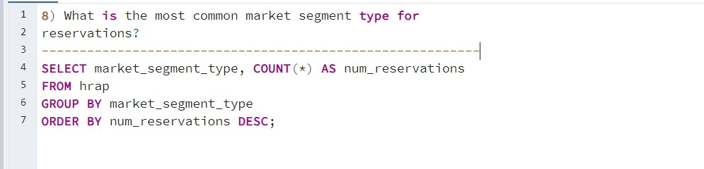
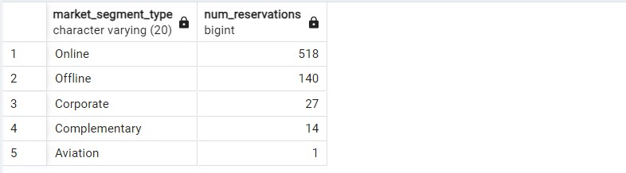

Slide 14
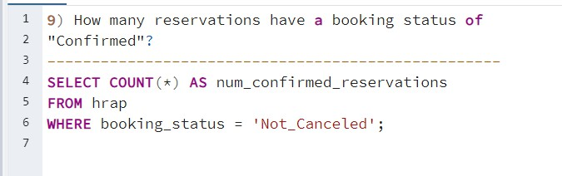
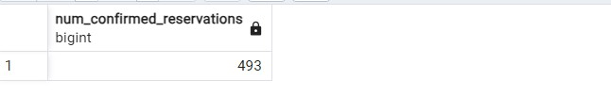

Slide 15
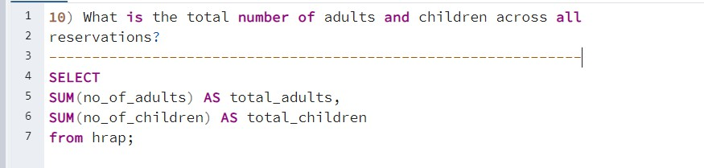
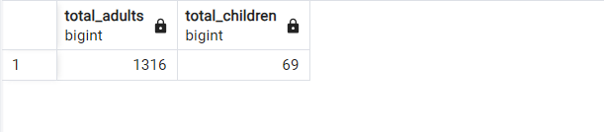

Slide 16
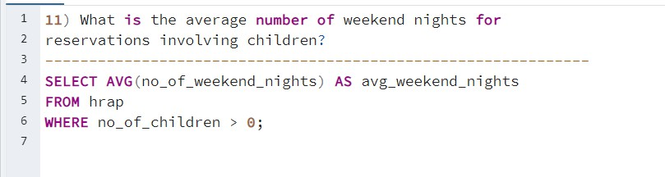
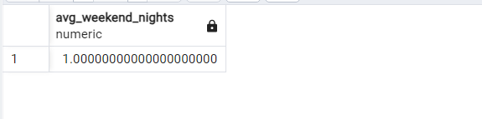

Slide 17
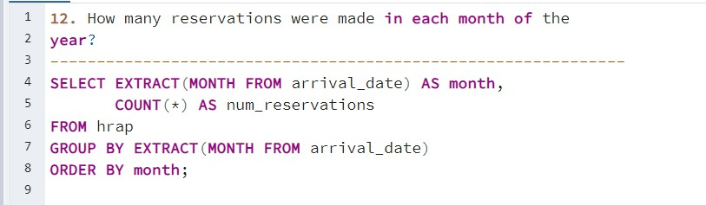
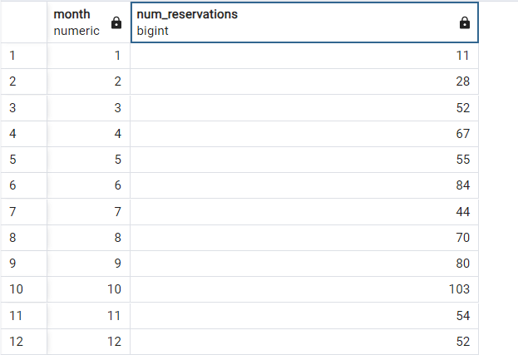

Slide 18
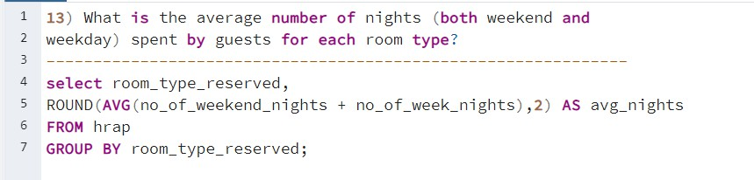
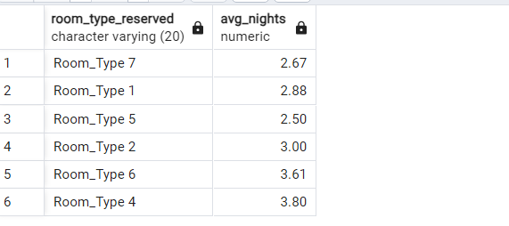

Slide 19
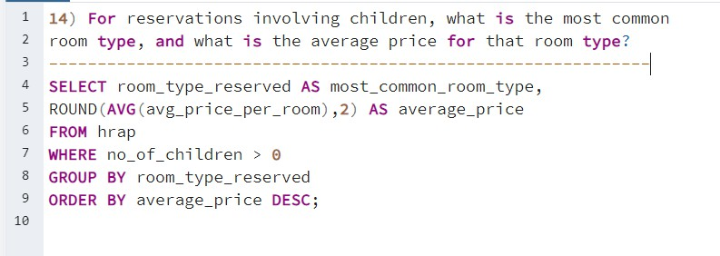
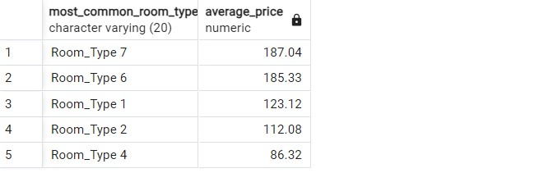

Slide 20
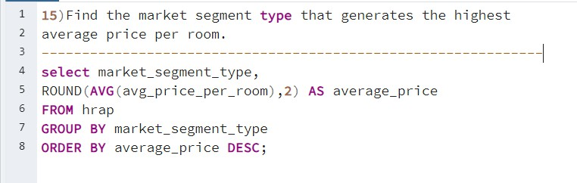
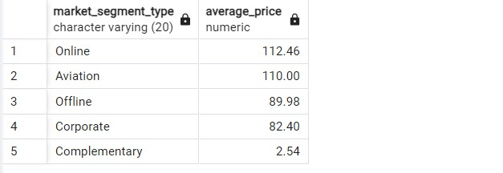

Slide 21
Summary:
Conclusion:
The hotel reservation data helps us to learn important things.We find out what meal plans and rooms guests like the most,so we can make sure we offer the right things.We slso learn how long people usually book advance and what kind of guests book with us .Looking at the reservation per year and month help us who are busy. Finally we figure out what type o guest pay the most for their rooms,so we can make more money. Overall using the data helps us run hotel better and make our guests happy.
SQL is a useful language for handling databases and pulling out important queries to analyze data quickly and efficiently.

Slide 22
Thankyou!

